Slide 1
Logistic Regression
Machine Learning Approach

Slide 2
Logistic regression
Logistic regression is a supervised machine learning algorithm used for classification problems, particularly for predicting a categorical dependent variable.
It predicts the probability of an input belonging to a specific class, most commonly a binary outcome like "yes" or "no"
Logistic regression is one of the most popular machine learning algorithms for binary classification.
It is a simple algorithm that performs very well on a wide range of problems.

Slide 3
How logistic regression works?
Logistic regression uses a logistic or sigmoid function to map its output to a probability value between 0 and 1.
Linear equation: The algorithm first calculates a linear combination of the input features, similar to linear regression.
$$x=b_{0}+b_{1}x_{1}+b_{2}x_{2}+…+b_{n}x_{n}$$

Slide 4
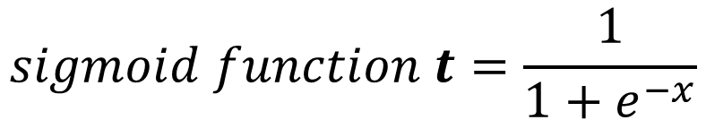
Sigmoid function: The linear output (x) is then passed through the sigmoid function, which squashes the result into probability between 0 and 1.
$$sigmoid function t=\frac{1}{1+e^{−x}}$$
Thresholding: A classification threshold, typically 0.5, is used to convert the probability into a class label. If the probability is above the threshold, the instance is assigned to one class (e.g., 1); otherwise, it's assigned to the other class (e.g., 0).

Slide 5
Training: The model is trained using a technique called Maximum Likelihood Estimation (MLE), which finds the optimal coefficients (b) that maximize the probability of observing the given data.

Slide 6
Types of logistic regression
Binary (or binomial): Used when the dependent variable has only two possible outcomes, such as "pass/fail," "spam/not spam," or "0/1".
Multinomial: Used when the dependent variable has three or more possible outcomes with no natural order. For example, classifying a flower species.
Ordinal: Used for a dependent variable with three or more ordered categories, such as a customer satisfaction rating of "low," "medium," or "high".

Slide 7
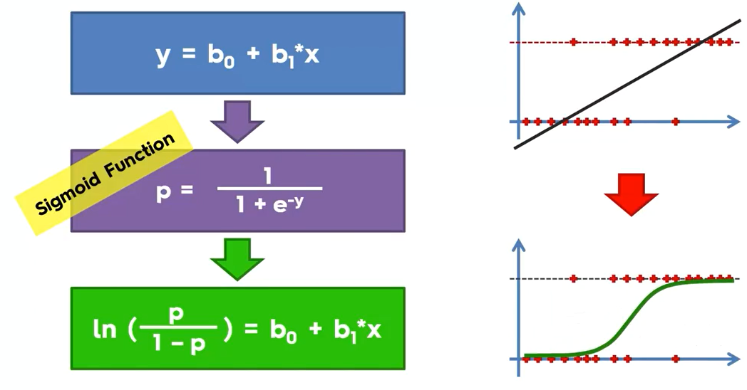

Slide 8
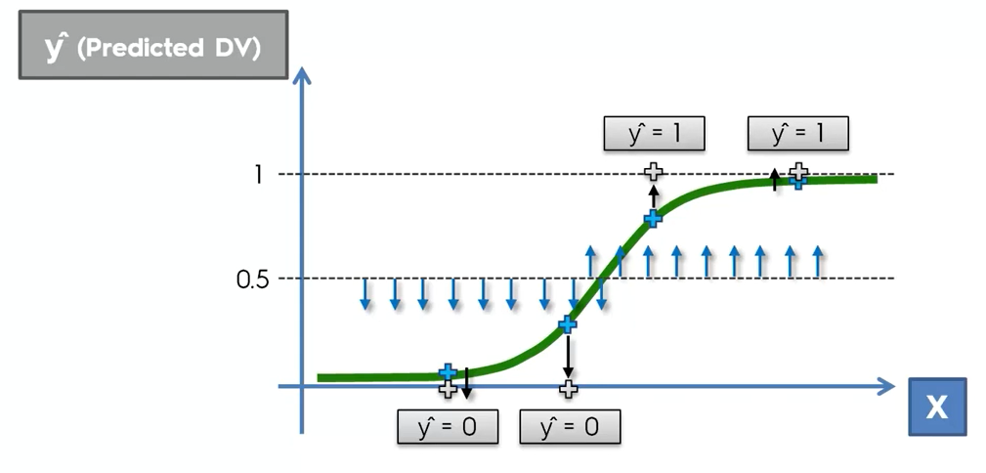

Slide 9
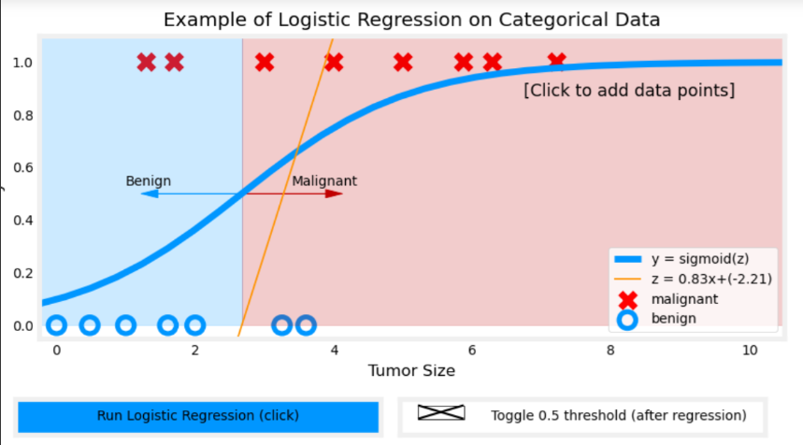

Slide 10
Apply logistic regression for the given dataset
Dataset has two input variables (X1 and X2) and one output variable (Y).
The input variables are real-valued random numbers drawn from a Gaussian distribution.
The output variable has two values, making the problem a binary classification problem.
Input Input Actual
Output
X1 X2 Y
2.7810836 2.550537003 0
1.465489372 2.362125076 0
3.396561688 4.400293529 0
1.38807019 1.850220317 0
3.06407232 3.005305973 0
7.627531214 2.759262235 1
5.332441248 2.088626775 1
6.922596716 1.77106367 1
8.675418651 -0.2420686549 1
7.673756466 3.508563011 1

Slide 11
Logistic Function
The logistic function is the heart of the logistic regression technique.
The logistic function is defined as:
transformed = 1 / (1 + e^{-x})
Where e is the numerical constant Euler’s number and x is a input we plug into the function.

Slide 12
Input Input Actual
Output
X1 X2 Y
2.7810836 2.550537003 0
1.465489372 2.362125076 0
3.396561688 4.400293529 0
1.38807019 1.850220317 0
3.06407232 3.005305973 0
7.627531214 2.759262235 1
5.332441248 2.088626775 1
6.922596716 1.77106367 1
8.675418651 -0.2420686549 1
7.673756466 3.508563011 1
transformed =
1 / (1 + e^{-output})
P_output =
if p(class) < 0.5) then 0 else 1
0.2987569857
0.145951056
0.08533326531
0.2197373144
0.2470590002
0.9547021348
0.8620341908
0.9717729051
0.9992954521
0.905489323
0
0
0
0
0
1
1
1
1
1
output = b0 + b1*x1 + b2*x2
Compare actual & prediction

Slide 13
Calculate Accuracy
Finally, we can calculate the accuracy for the model on the training dataset:
accuracy = (correct predictions / num predictions made) * 100
accuracy = (10 /10) * 100
accuracy = 100%

Slide 14
Self study
Advantages and disadvantages of logistic regression
How to evaluate a logistic regression model?

Slide 15
Thank you

